Slide 1

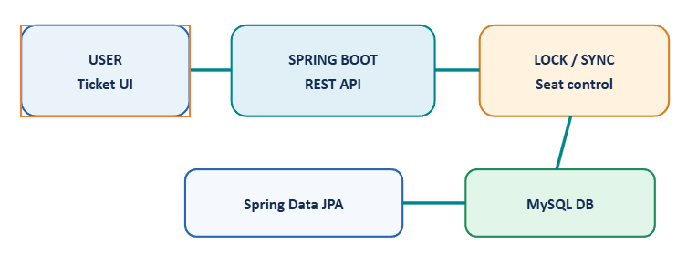
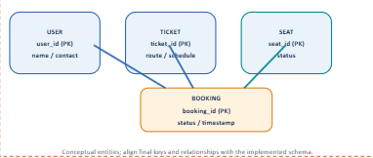
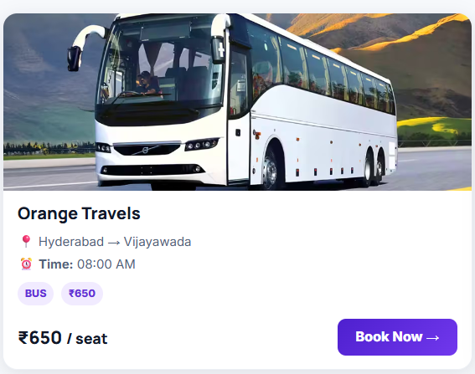
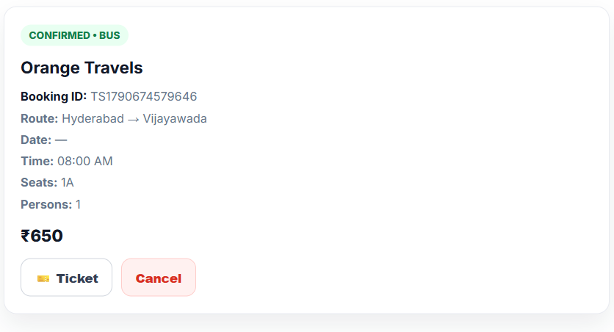
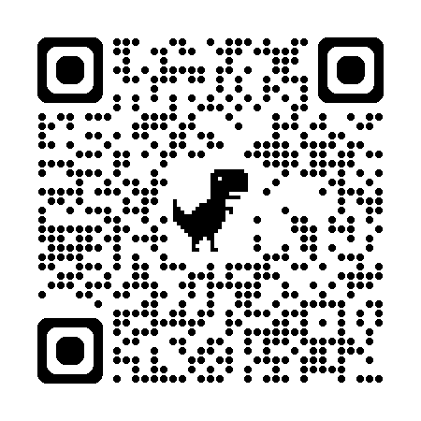
KLH Logo
[TICKET BOOKING SYSTEM CONCURRENCY SAFE]
Team ID: [23] | Section: [S12] | Members: [R SAI CHARAN REDDI – 2520090184], [G MANIDEEP –2520090100], [P AKHIL YADAV – 2520090155] | Guide: [Dr.SK KHAJA SHAREEF]
Database Systems Engineering and Distributed Backend Development (25CS1302E) | KLH Bachupally Campus, CSE | PBL 2026-27
Abstract
Tools & Technologies
A reliable ticket reservation system designed for multiple users booking tickets simultaneously. It maintains real-time seat availability and uses concurrency-control techniques to ensure that only one user can reserve a particular seat.
Key Benefit: Prevents duplicate bookings and maintains accurate booking records.
Front-End: Java
Back-End: Spring Boot + Rest APIs
Database: MYSQL –user,ticket,seat and booking data
Tools: [Git & GitHub, Postman, VS Code, Draw.io]
Problem Statement & Objectives
Problem: Concurrent users may reserve the same seat, causing double booking and inconsistent requests.
Objective 1: Keep seat availability accurate during concurrent requests.
Objective 2: Let users view tickets, select seats, and confirm bookings.
Objective 3: Protect shared booking resources using synchronization / locking.
Scope:Ticket availability, seat selection, reservation, and confirmation.
System Architecture
[Insert architecture diagram: Front-End – REST API – Database]
Existing vs Proposed System
Feature` | Existing System | Proposed System
[Feature 1] | Double –booking risk | Concurrency Safe Reservation
[Feature 2] | Can Become Inconsistent | Update after successful booking
[Feature 3] | Conflicting transactions | Consistent booking records
[Feature 4] | Shared seat conflicts | locking
[Limitation / Gap] | Unsafe coordination | One successful claim
ER Diagram & Database Design
[Insert ER diagram with entities, keys and relationships]
Feasibility Study
Technical: Java, Spring Boot, Spring Data JPA, MySQL and Java concurrency utilities.
Economic: Uses widely available development tools and open-source frameworks.
Operational: View tickets → choose seats → book → receive confirmation.
Schedule: Semester PBL project; milestone dates were not specified in the abstract.
Implementation Screenshots
[Screenshot 1]
[Screenshot 2]
Results & Testing
Conclusion
Future Scope
Goal: Prevent duplicate seat reservations during concurrent access.]
Test: Submit simultaneous requests for one seat; verify one successful reservation.
Outcome: Ticket booking workflow designed around concurrency control and consistent records.
Value: Improves reliability when many users book simultaneously.
Next: Authentication, payment integration and cancellation.
Scale: Load testing, deployment and monitoring.
References: [1] [Author, Title, Year] [2] [Website / Documentation link] [3] [Paper / Book]
QR: GitHub

